Slide 1

NumPy Basics
Today’s Agenda
What is NumPy & Why use it?
NumPy Arrays vs Python Lists
Array Creation & Attributes
Array Operations & Indexing
Hands-On Practice
Kahoot(Quiz)

Slide 2
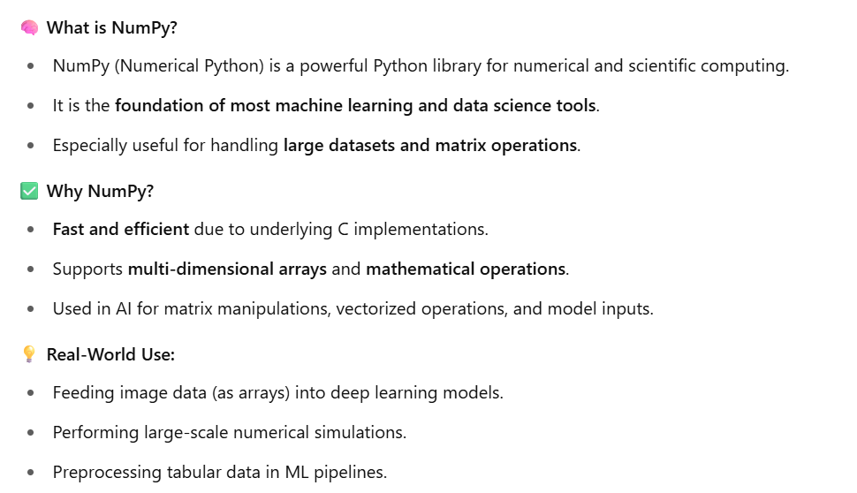
What is NumPy & Why Use It?

Slide 3
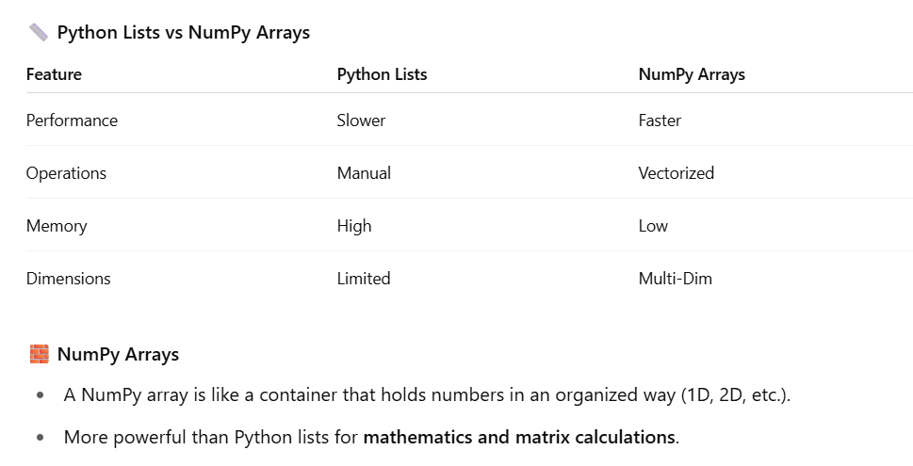
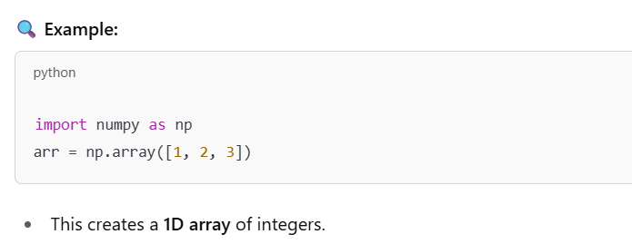
NumPy Arrays vs Python Lists

Slide 4
Short Break

Slide 5
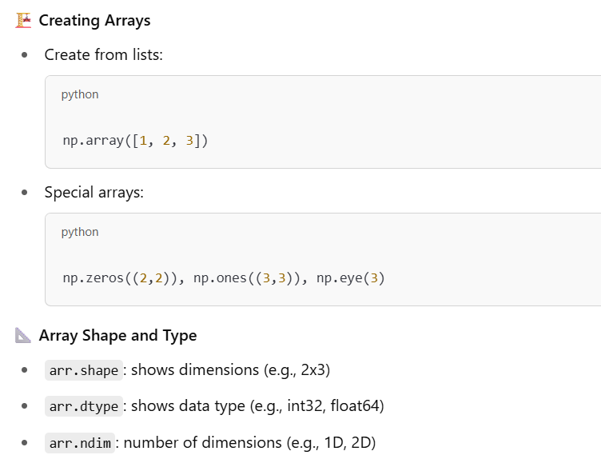
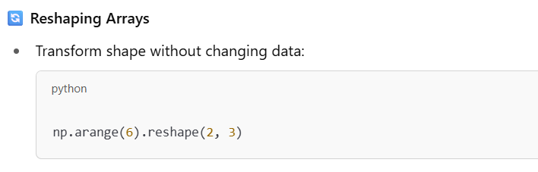
Array Creation & Attributes

Slide 6
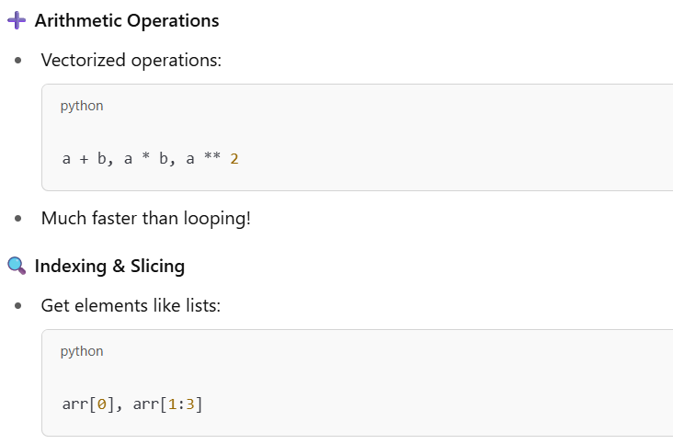
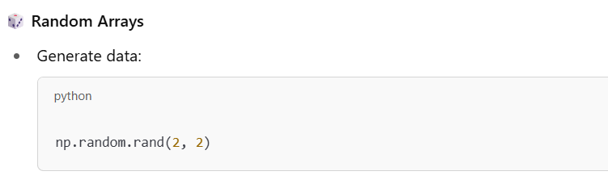
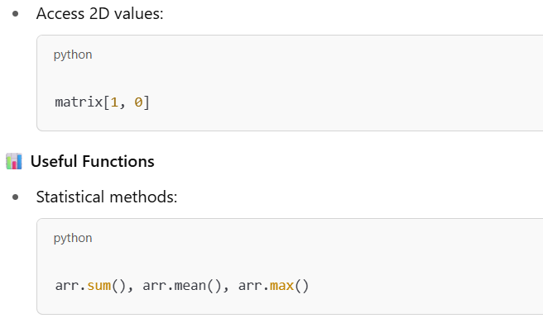
Array Operations & Indexing

Slide 7
Main Break

